Slide 1
Lesson 1, Part A: Soil
Click here for audio
Notes:
Welcome to protecting our watersheds! Today we will be exploring soil. What is soil made of? Why is soil important? Let’s find out!

Slide 2
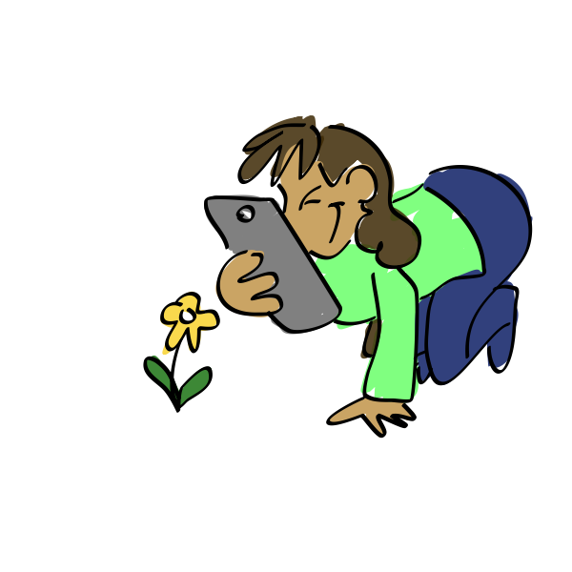
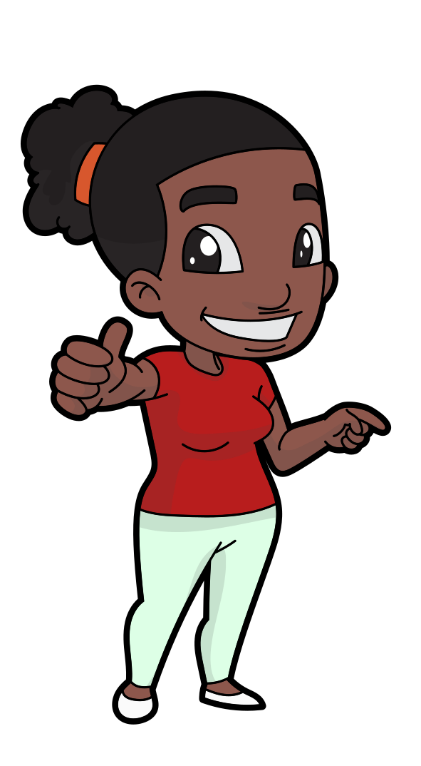
What skills will we use today?
Staying focused
Thinking like a scientist
Following instructions
Notes:
What skills will we use in our lesson today? Today we will be thinking like a scientist, staying focused on the task at hand, and following instructions. Where are these skills on your comfort zone scale?

Slide 3
Growth Edge
Comfort Zone
YIKES!
Notes:
Think about where the previous skills land in your comfort zone. Are they in the middle of your comfort zone, or closer to the growth edge? Maybe one of those skills are in your yikes zone. Remember to work together to grow your comfort zones!

Slide 4
What is soil?
Notes:
What is soil? Soil, or dirt, is made up of a lot of different things. Soil is a mixture of rocks, plants, roots, decaying organisms, sand, and all of different sizes! Soil is essential for human life - not only do we rely on it as solid ground to physically build our homes and lives on, but soil helps create our food! Soil is where life begins, ends, and starts over again!

Slide 5
What is soil?
Earth materials and Organic materials
Notes:
Soil is made up of two main categories: Earth materials and Organic materials. Earth materials are the various solids, liquids, and gases that make up the Earth. All the different sized rocks, water, and air found in soil are the earth materials. Organic materials are all the remains of dead plants and animals that break down in the soil, such as leaves or roots.

Slide 6
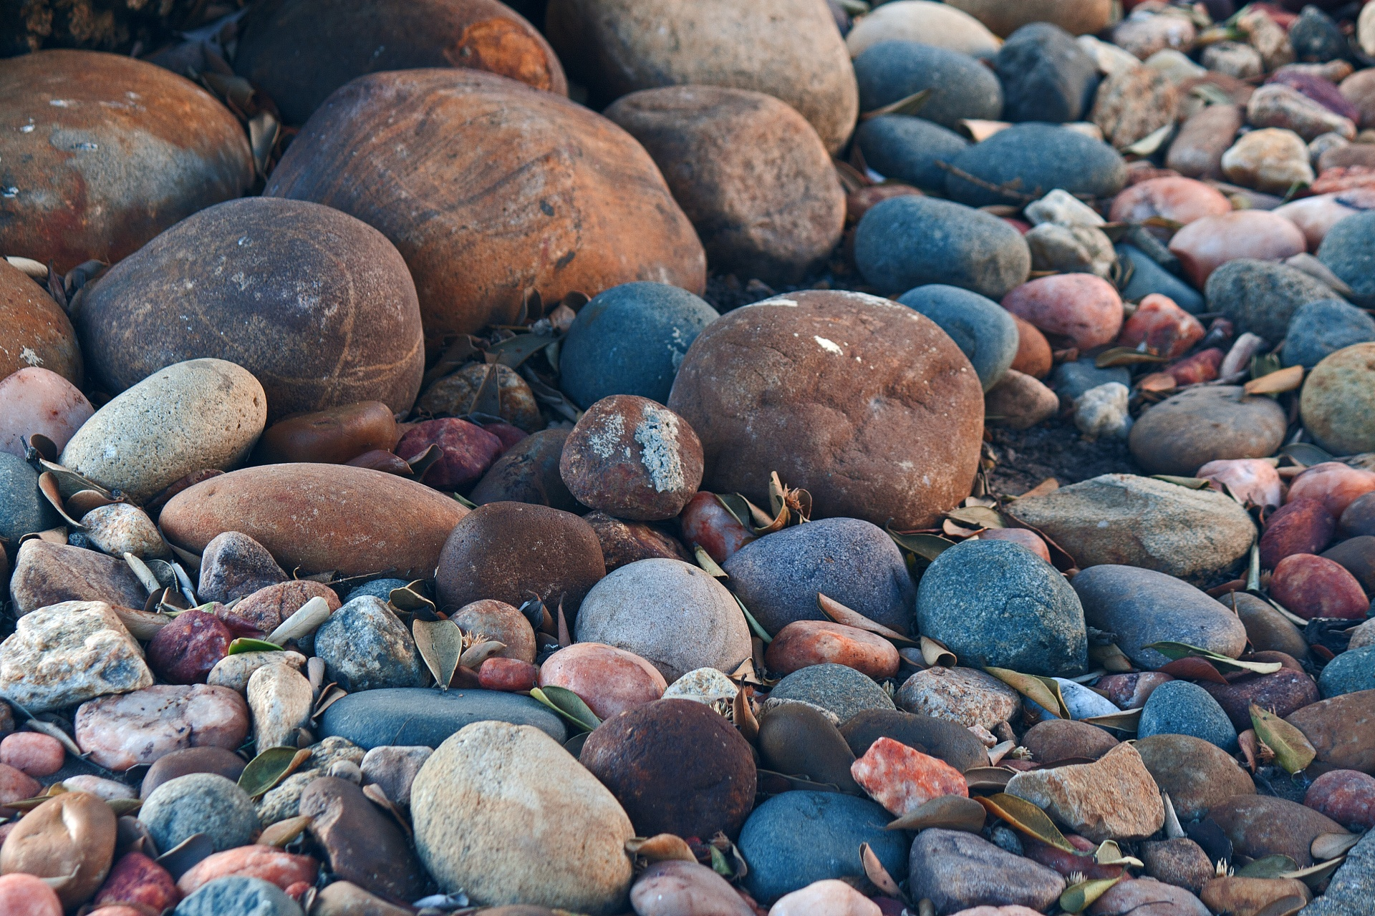
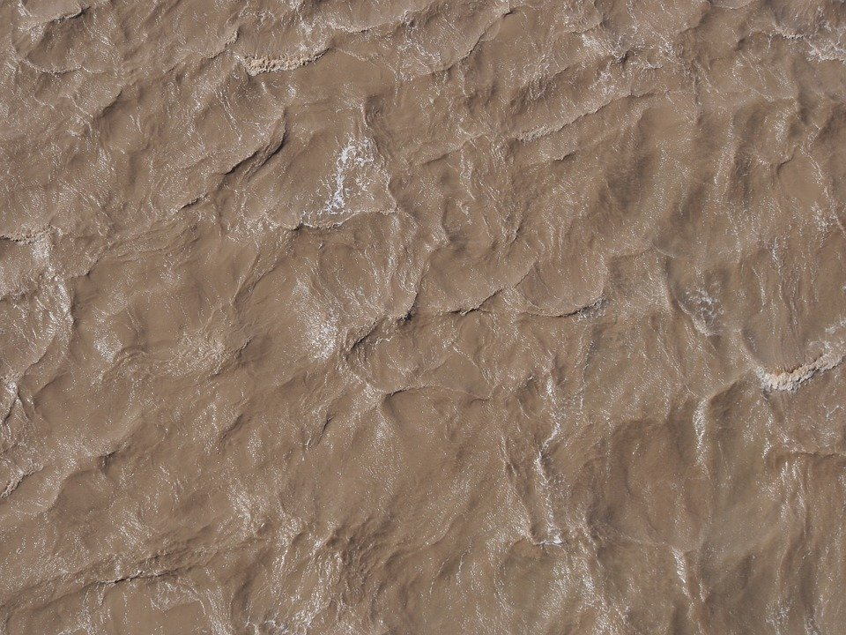
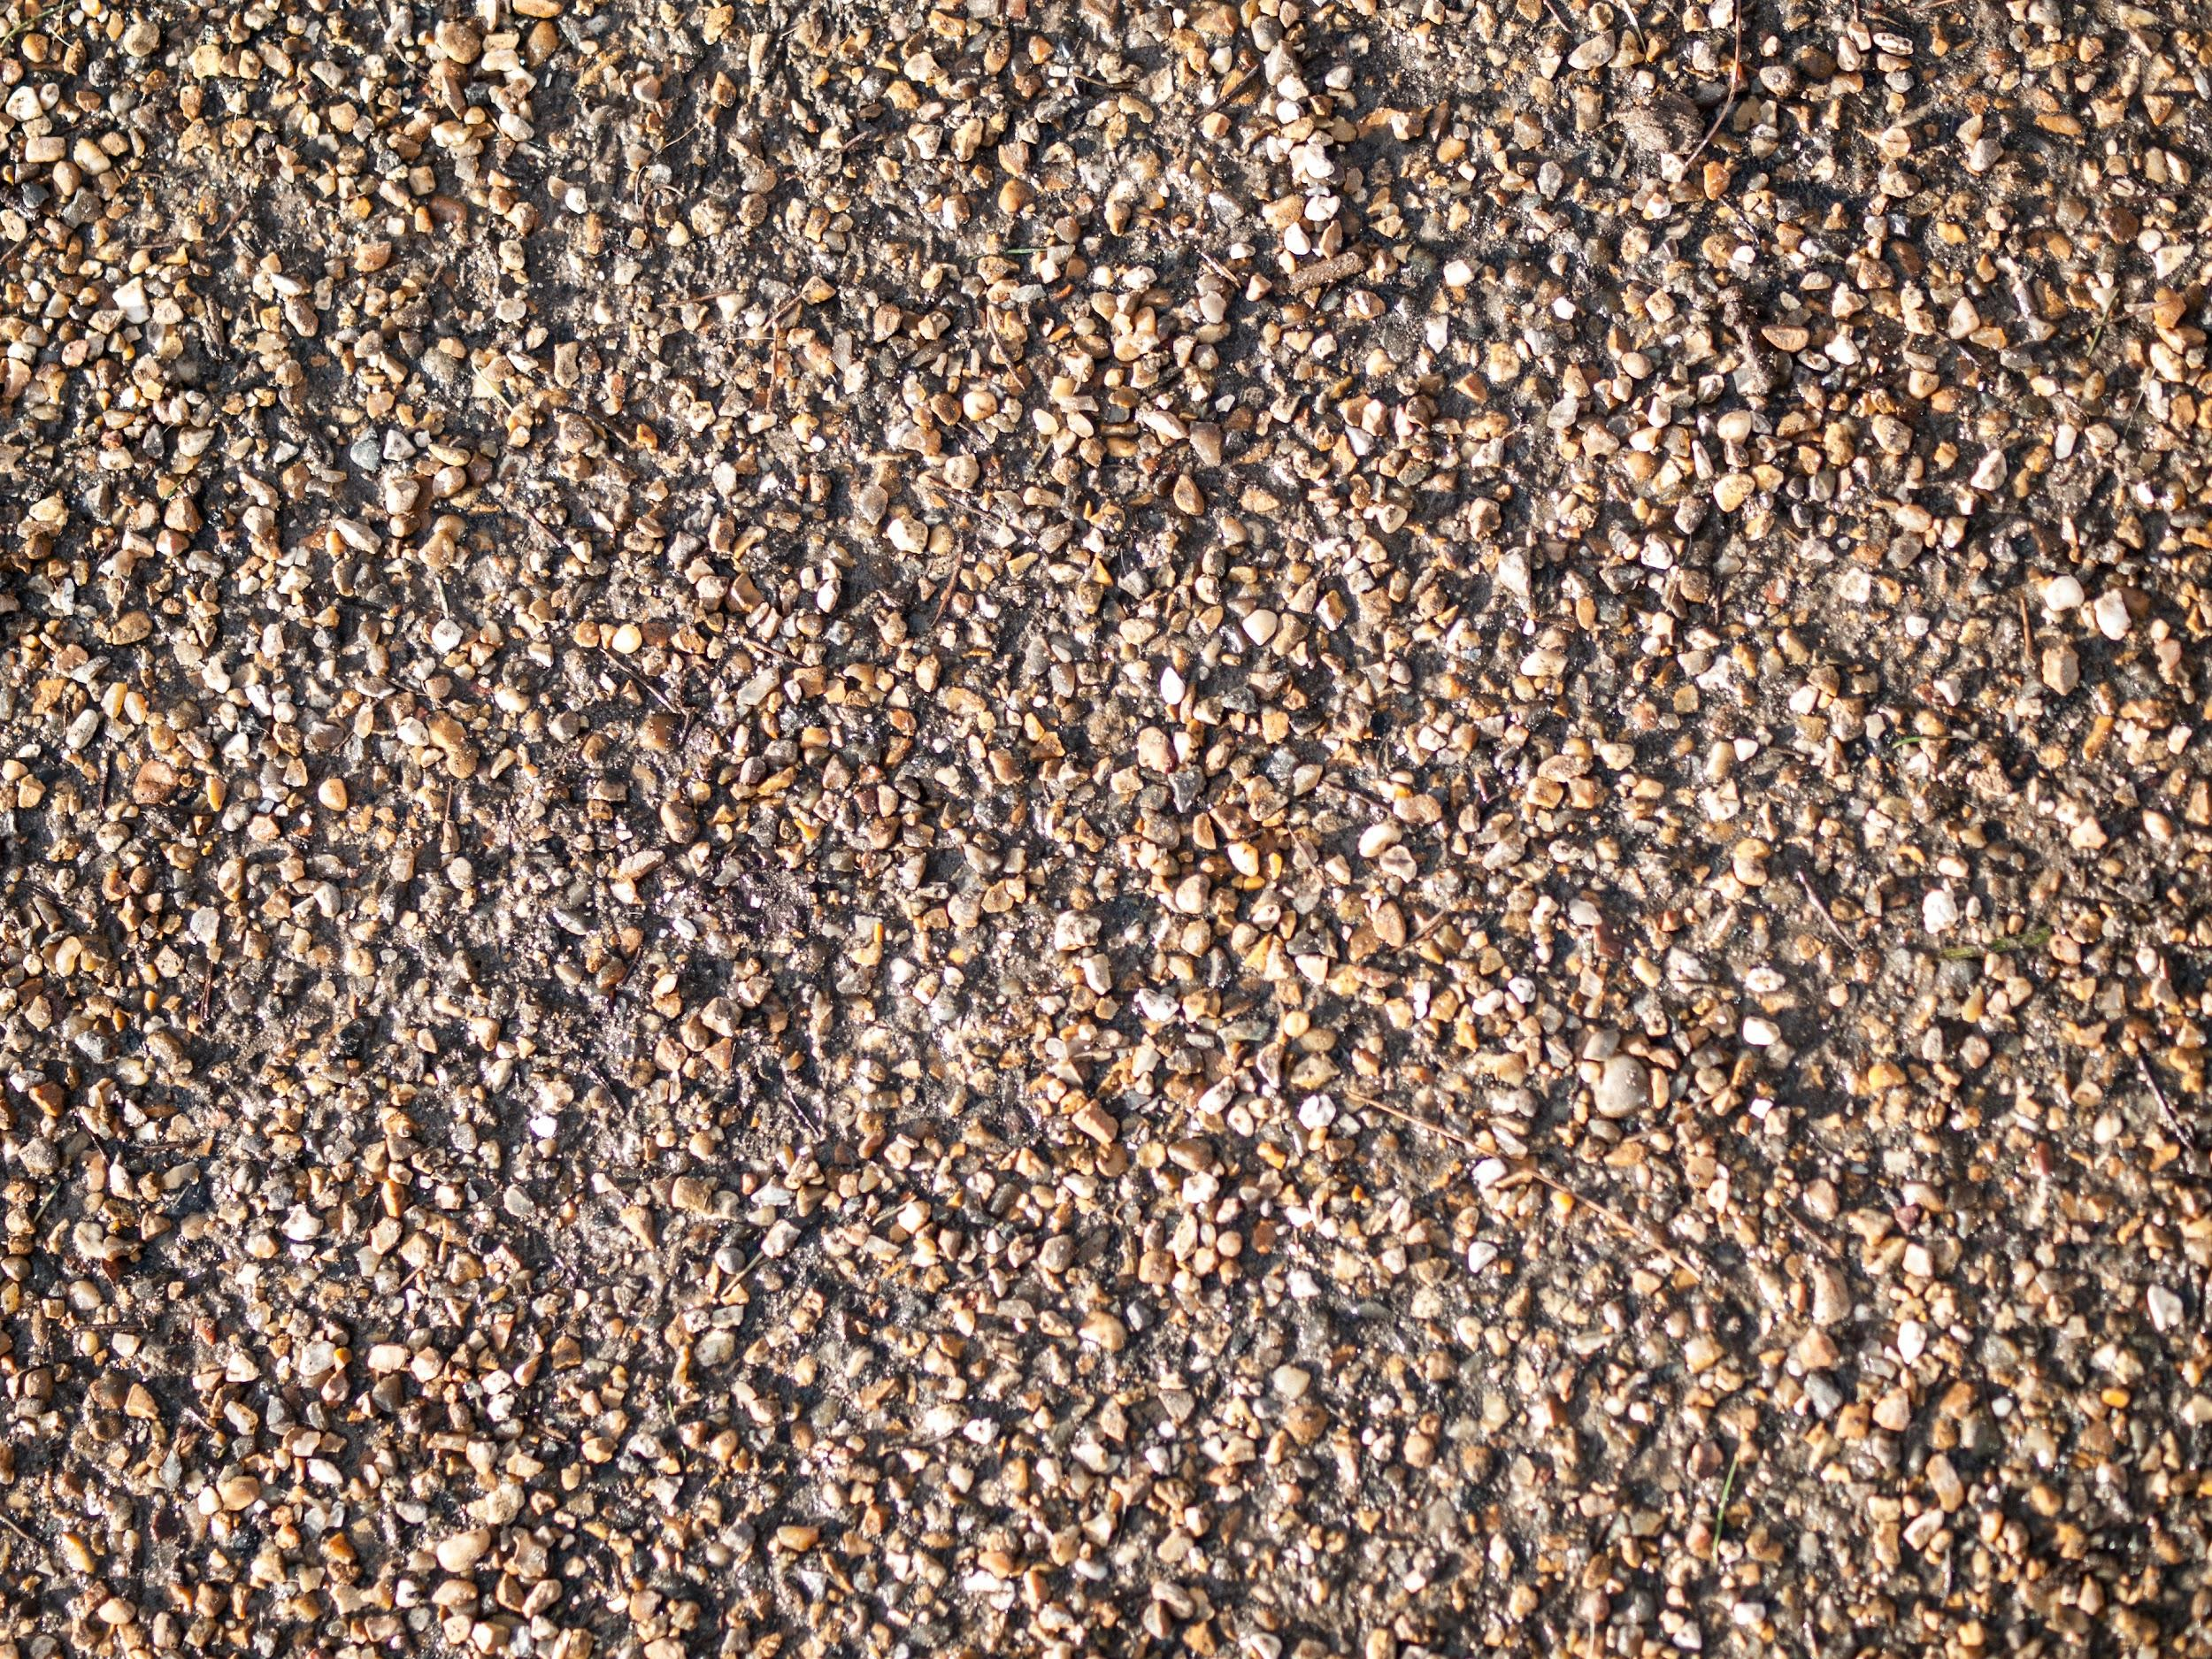
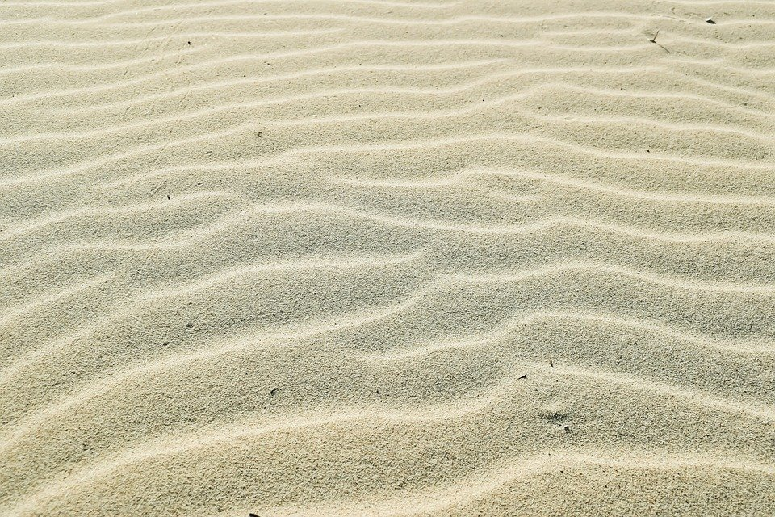
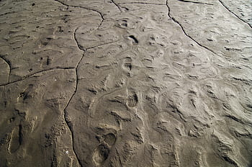
Earth materials
Pebbles
Diggable earth material usually containing:
Silt
Gravel
Sand
Clay
Notes:
In soil, we describe diggable, solid earth materials by their size. Diggable earth material might contain: Pebbles, gravel, sand, silt, or clay. Some soils might have a mixture of all these different sized rocks, while some soils might be made of all one size - like all sand or all clay.

Slide 7
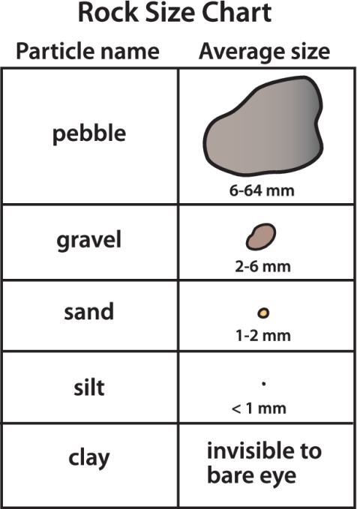
Earth material in soil
Notes:
Pebbles are the largest rocks found in soil, with an average size between 6-64mm. For reference, that’s between the size of a tennis ball down to about a pencil eraser. Rocks that are between 2-6mm are called gravel. Gravel is smaller than a pencil eraser but larger than the thickness of a nickel coin. As rocks break down further into 1-2mm pieces, we call this sand. Rock particles that are smaller than 1mm are called silt. When pieces become too small to see with the eye alone, we call this clay. Clay becomes very slippery and sticky when wet.

Slide 8
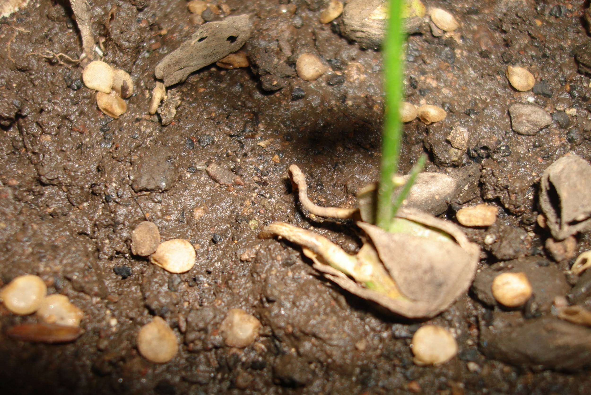
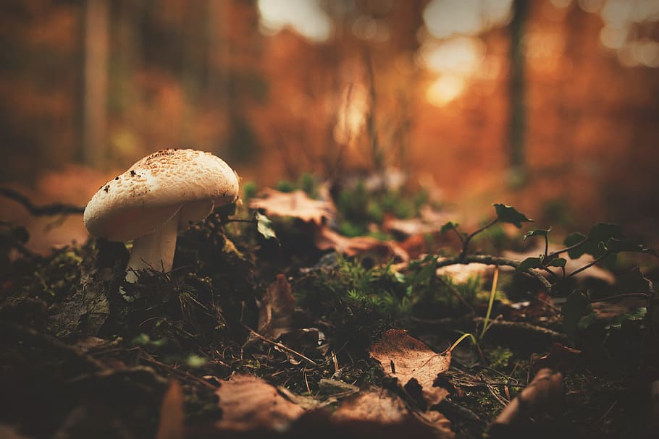
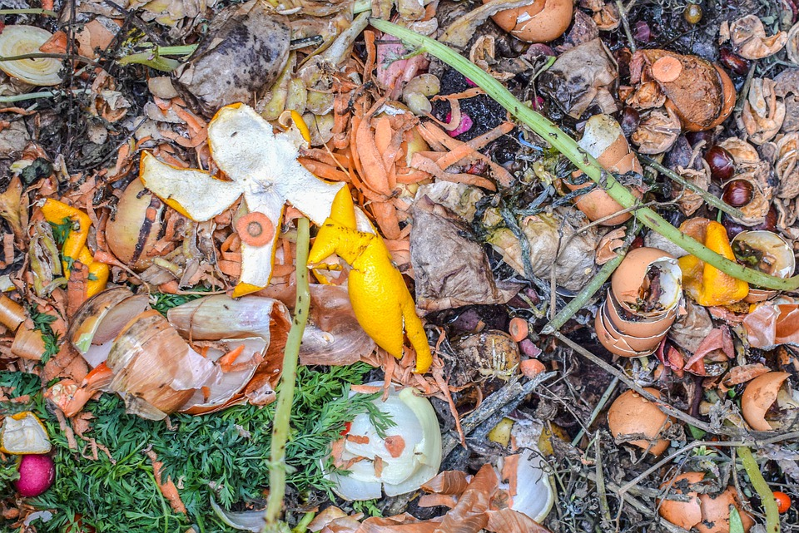
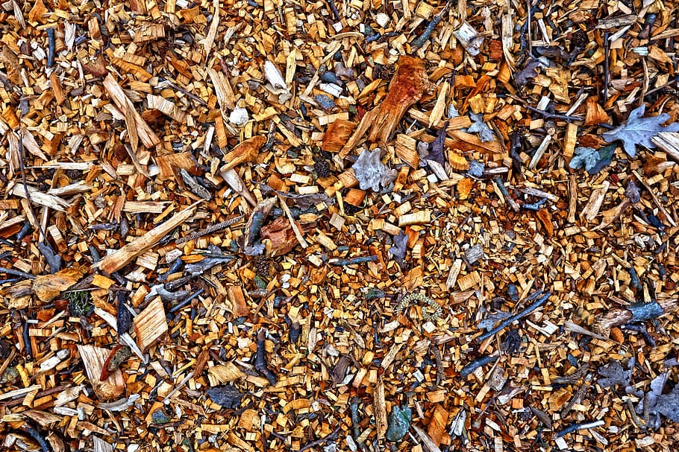
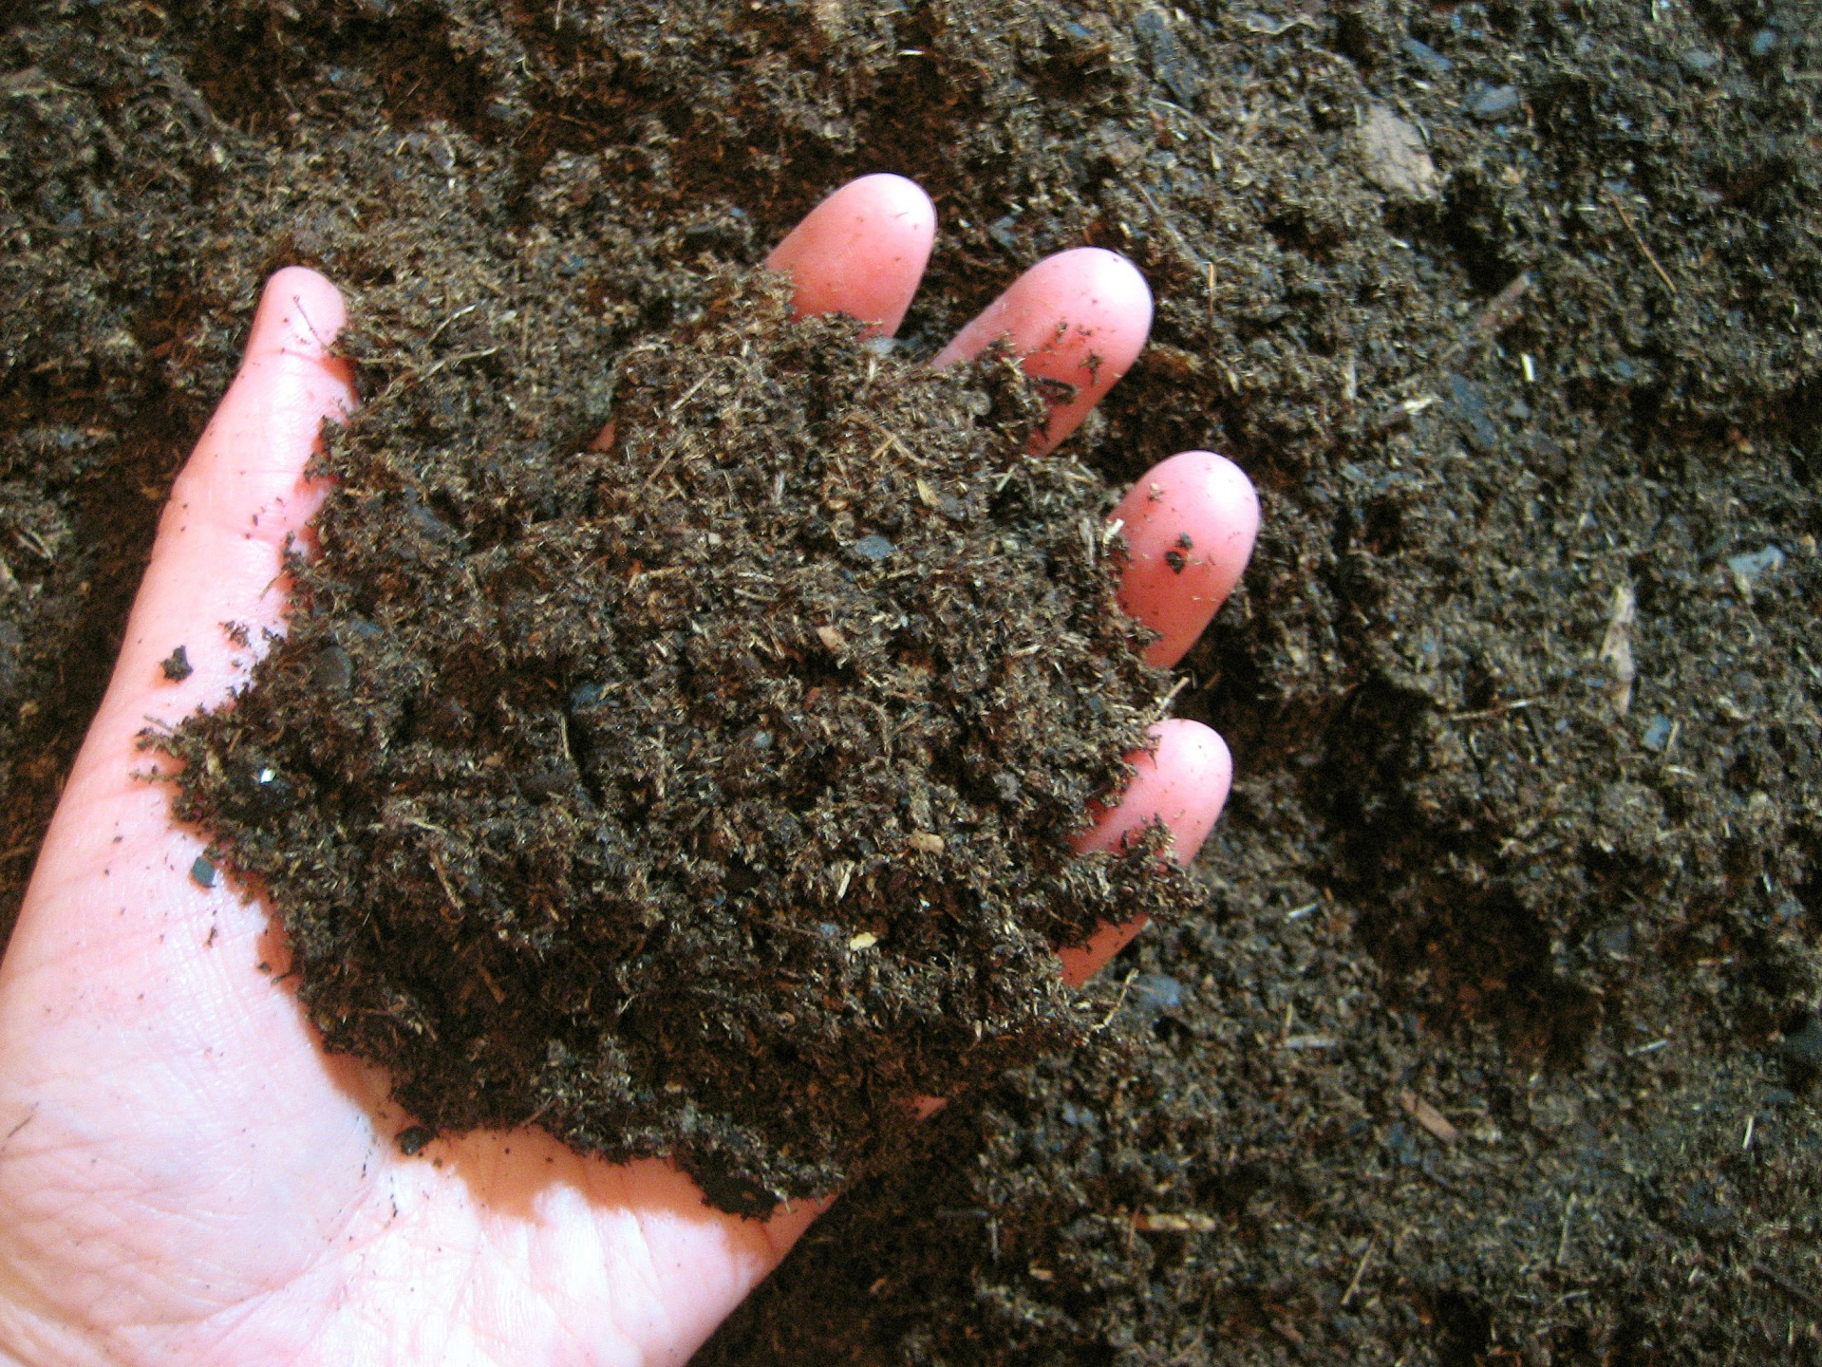
Organic materials
The remains of dead plants and animals
As the organic material decays, it breaks down into tiny pieces of soil organic matter.
Organic materials are very important! They provide nutrients and help
retain water
Notes:
Organic materials are the remains of dead plants and animals found in soil. As the organic material decays, it breaks down into tiny pieces of soil organic matter. Organic materials are very important to soil. They provide nutrients to support life that grows from the soil, and they help retain or hold water.

Slide 9
Have you ever wondered what makes up the soil in your backyard or at your school?
Activity time!
Let’s explore!
Find a spot around your home or school with soil (make sure you have permission to grab soil from there!)
Grab a handful of soil and place it on a paper plate,
paper towel, or a flat surface.
Separate the different pieces of soil you find
by size and material
Growth Edge
Comfort Zone
Don’t forget your comfort zone!
Notes:
Have you ever wondered what makes up the soil in your backyard? Let’s explore! First, find a spot around your home or school with soil (make sure you have permission to grab soil from that spot). Then, grab a handful of soil and place it on a paper plate, a paper towel, or just a flat surface will do. Lastly, separate the different pieces of soil you find by size and material. Let’s see what you find.

Slide 10
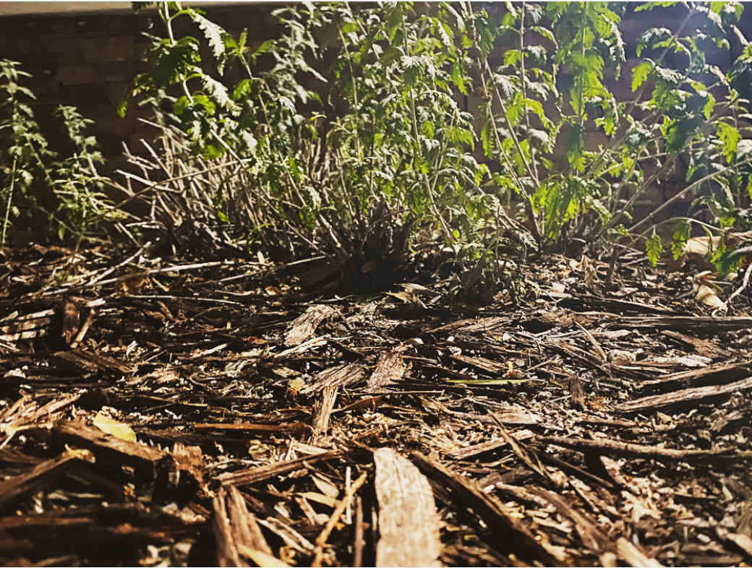
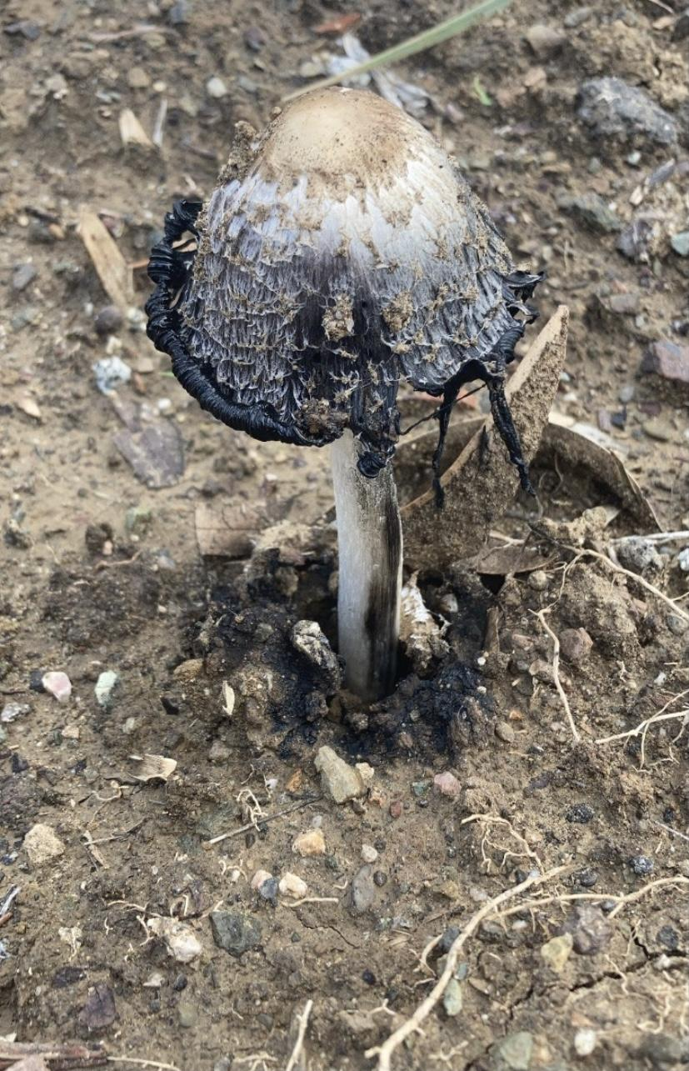
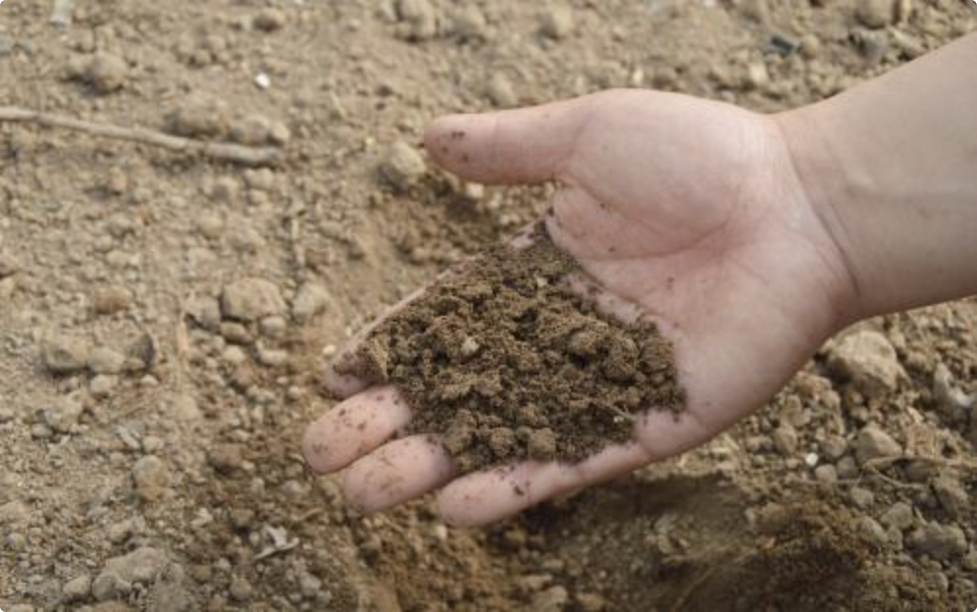
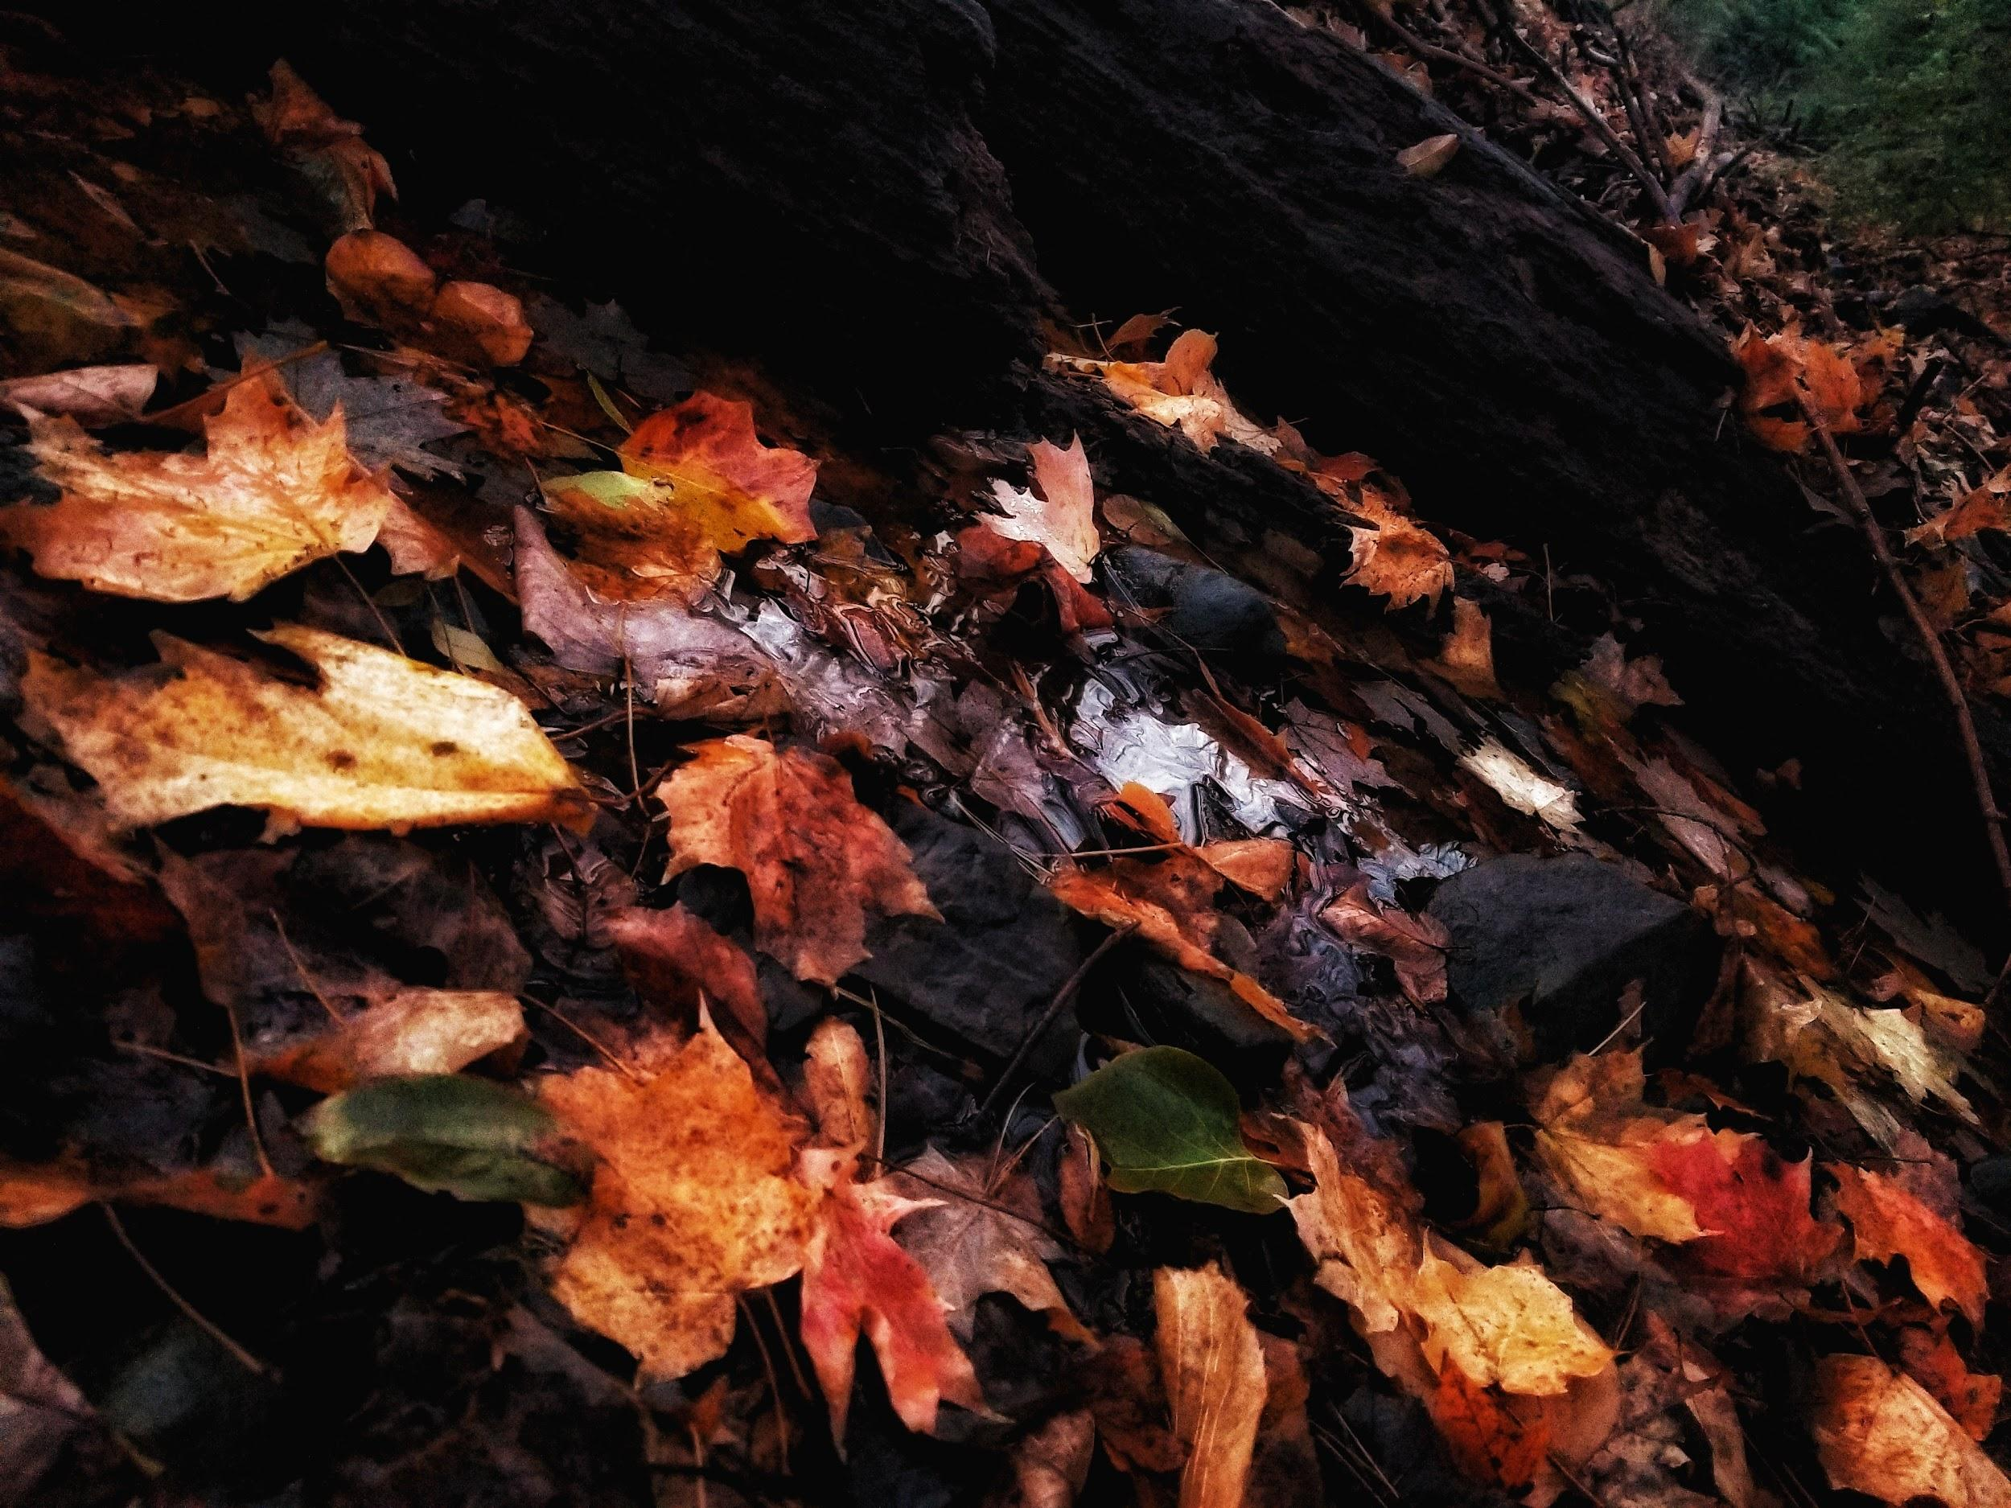
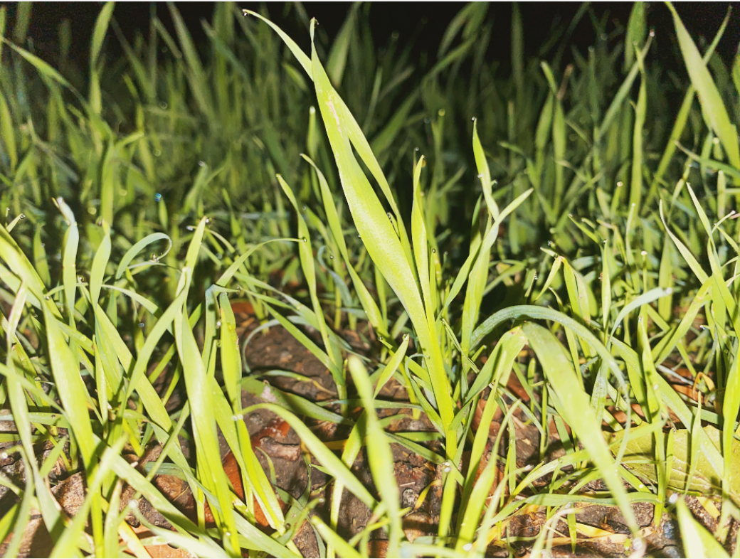
What materials did you find in your soil?
What kind of plant life did you find growing around it?
Was it wet or dry?
How would you describe it?
Notes:
What materials did you find in your soil? What kind of plant life did you find growing around it? Was it wet or dry? How would you describe it? What different colors did you find in your soil? Write your answers down in your notebook, on a piece of paper, or in a google form provided by your teacher.

Slide 11
Soil is SO important! So important, that there are people that study and work with soil for a living.
What is it like to study soil as a job? And why is it so important? Let’s find out from a local soil scientist!

Slide 12
Interview with Yamina Pressler - a local soil scientist

Slide 13
What did we learn?
We learned …
what soil is made up of
the difference between earth material and organic material
soil is defined by the size of the earth material in it
what a soil scientist is and why it’s important to study soil
In part B of this lesson, we will explore soil through art!

Slide 14
Thanks for exploring with us! See you soon!
Notes:
Thanks for exploring with us, see you soon!

Slide 15
Lesson 1, Part B: Soil
Notes:
Welcome back to protecting our watersheds! Today we will explore soil further with the help of local soil scientist Yamina Pressler, and then use soil to create art! Let’s dig in!

Slide 16
Stop and think!
Do you remember…
what soil is made up of?
what are some different kinds of earth materials? Can you name 3 different kinds? What’s the difference between them?
what soil organic material is?
what a soil scientist is?
Let’s have some fun and explore soil with art!

Slide 17
What skills will we use today?
Sharing equipment
Being creative
Being confident
Following instructions
Growth Edge
Comfort Zone
YIKES!
Notes:
What skills will we use in our activity today? Today we will be sharing equipment, being creative, following instructions, and being confident in our painting abilities. Where are these skills on your comfort zone scale?

Slide 18
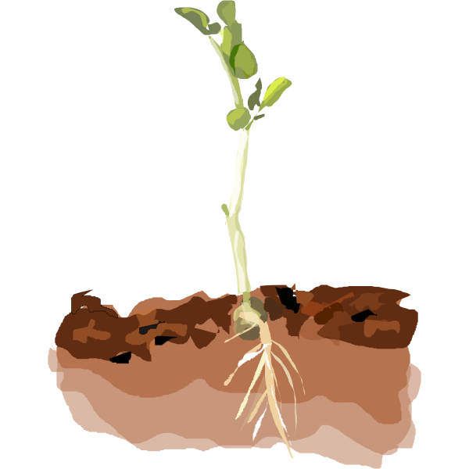
Activity: Painting with soil
Dr. Pressler helps people connect with soil through artwork - and now it’s your turn!
Instructions:
Materials: Soil paint palettes, paintbrushes, cups of water, paper towels, 2 medium-sized pieces of paper (watercolor paper if available), 1 scrap piece of paper, and an open mind!
You may be sharing paint palettes in groups, or you may have an individual paint card.
Once you have your materials, Dr. Pressler will guide you through your soil painting session in a video on the next slide.
Notes:
Work in progress

Slide 20
Thanks for exploring with us!
Notes:
Thanks for exploring with us, and thanks for protecting our watersheds.

Slide 21
Lesson 1, Part C:
What soil means to me
Notes:
Welcome back to protecting our watersheds! Today we will dig even deeper and think about what soil means to us. Make sure you have your soil art from Part B, as you will need them for this next assignment.

Slide 22
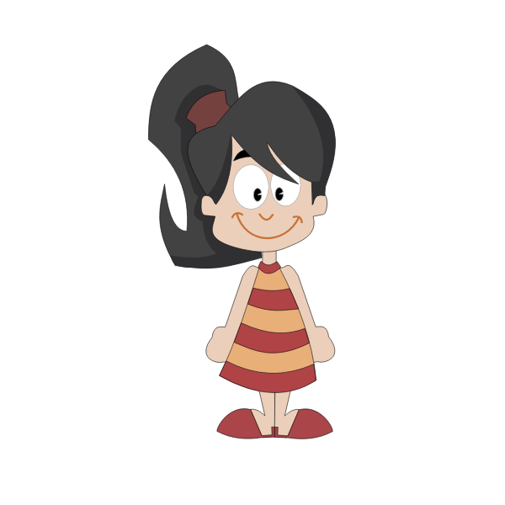
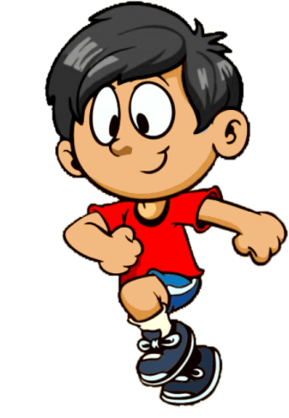
What skills will we use today?
Being open to different perspectives
Being creative
Sharing ideas
Being confident
Growth Edge
Comfort Zone
YIKES!
Notes:
What skills will we use in our activity today? Today we will be working on our communication skills and our teamwork skills. Throughout the assignment, we will practice being open to different perspectives, sharing ideas, being confident in how we express ourselves, and being creative and maybe trying something new. Where are these skills on your comfort zone scale?

Slide 23
What does soil mean to you?
In this assignment, you will finish the following sentence: “Soil is important to me because…” and present your answer in an art form of your choice.
Instructions:
Your teacher will put you into groups of two or three
Place each of your pieces of artwork next to each other, and take a photo of them.
This image of your combined soils will be your background image for your presentation!
Using the green screen in the iInnovate lab, record your group completing
the sentence above.
Be creative in your responses!
You can stand in front and read your response
You can write a poem
You can create an interpretive dance
You can sing
Any other ideas?
Growth Edge
Comfort Zone
Don’t forget your comfort zone!

Slide 24
Vocabulary Review
Earth Materials: any natural resource that makes up earth, including soil and water
Rock: a solid earth material made of two or more minerals
Pebbles: weathered rock material with particles typically between 6–64 mm
Gravel: weathered rock material with particles typically between 2–6 mm
Sand: weathered rock material with particles typically between 1–2 mm
Silt: rocks that are smaller than sand but bigger than clay
Clay: rocks that are too small to see without a hand lens

Slide 25
Vocabulary Review
Organic Materials: the remains of dead plants and animals that decay in the soil
Decay: when dead plants or animals break down into small pieces

Slide 26
Thanks for exploring with us!
Notes:
Thanks for exploring with us, and thanks for protecting our watersheds.

