Slide 1
Lesson 1, Part A: Water in Nature
Notes:
Hello, and welcome to protecting our watersheds - inquiry to action. Today we will be exploring water in nature in part A of this lesson.

Slide 2
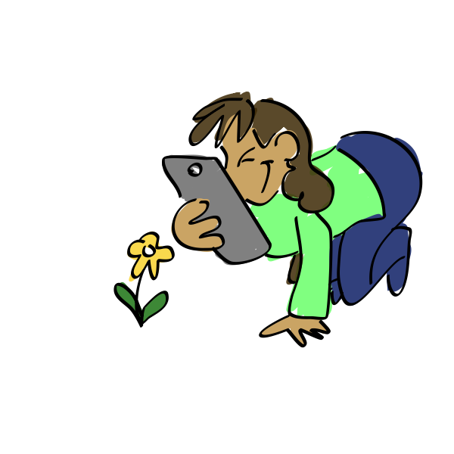
What skills will we use today?
Being creative
Being curious
Pausing for others to speak
Speaking up and sharing my ideas
Being open minded
Notes:
In our activity today we will have a chance to work on our communication skills and our critical thinking skills. These skills include being curious, speaking up and sharing our ideas in a group setting, pausing for others to speak, being open minded and accepting new ideas, and thinking creatively. Where are these skills on your comfort zone scale?

Slide 3
Growth Edge
Comfort Zone
YIKES!
Notes:
Think about where the previous skills land in your comfort zone. Are they in the middle of your comfort zone, or closer to the growth edge? Maybe one of those skills are in your yikes zone. Remember to work together to grow your comfort zones!

Slide 4
Focus Question:
What is the effect of rain on natural materials?

Slide 5
Water is everywhere!

Slide 6
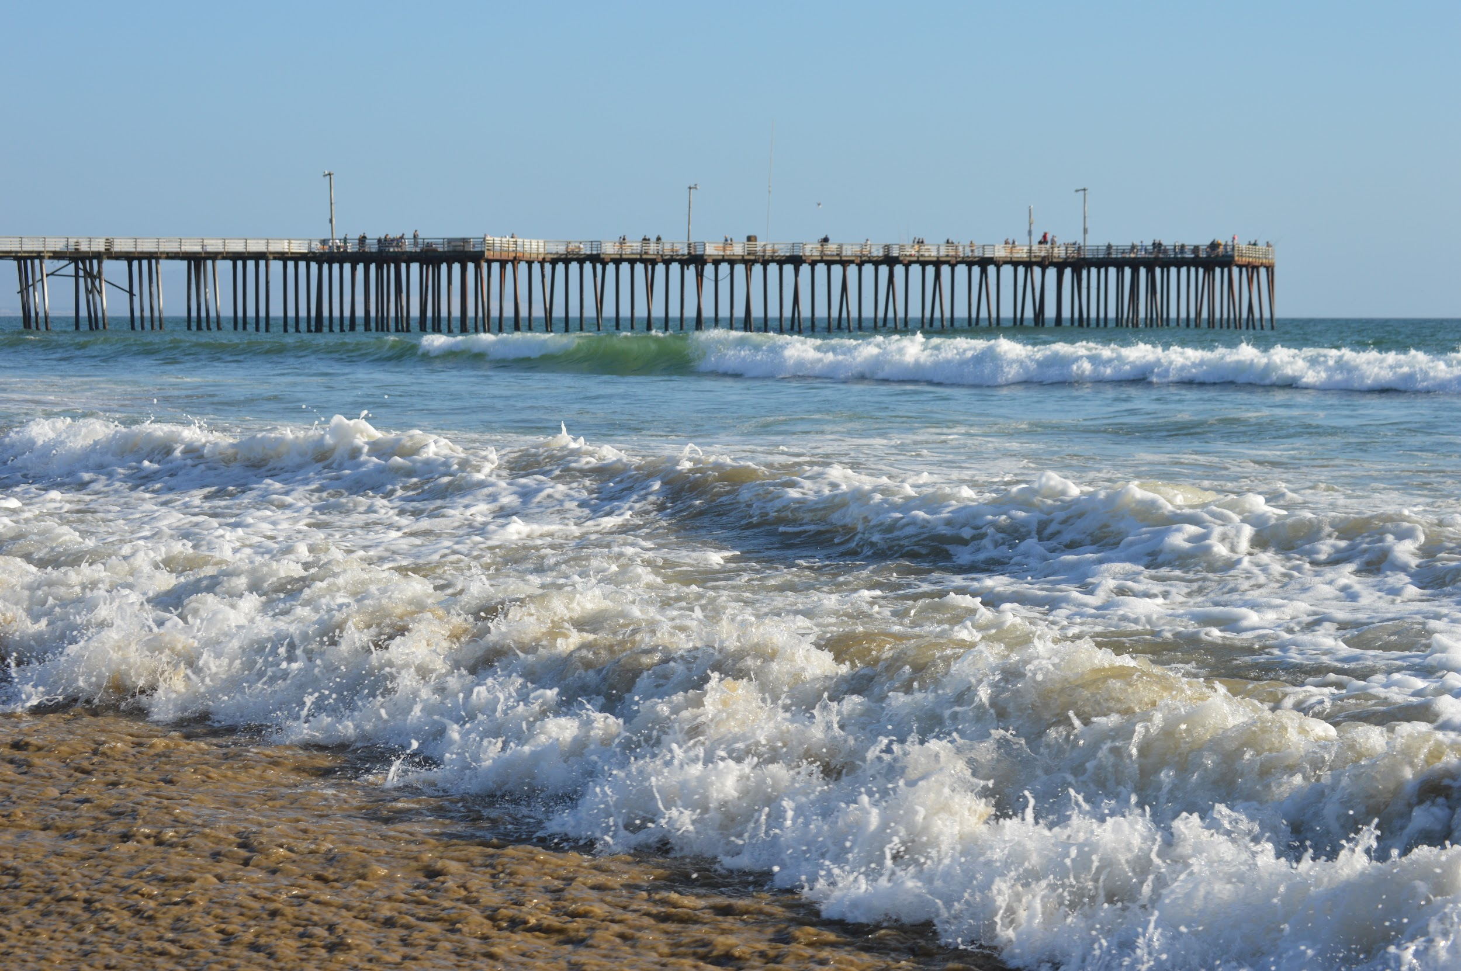
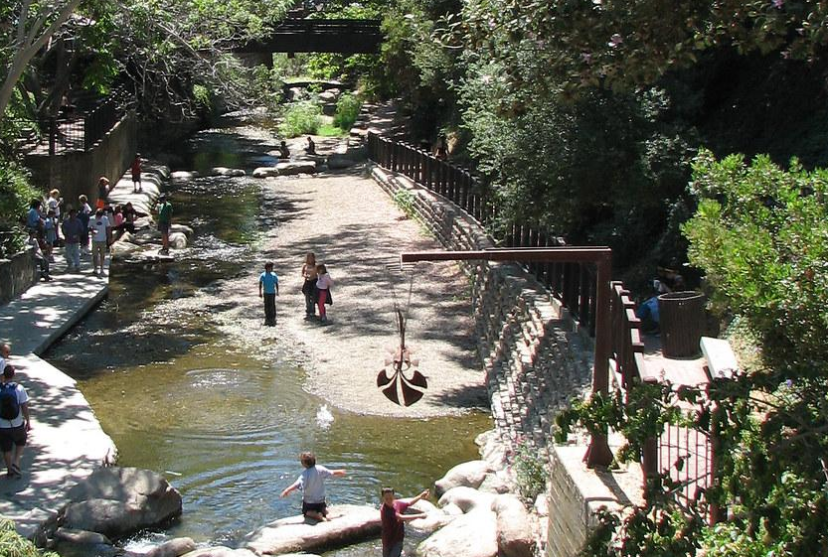
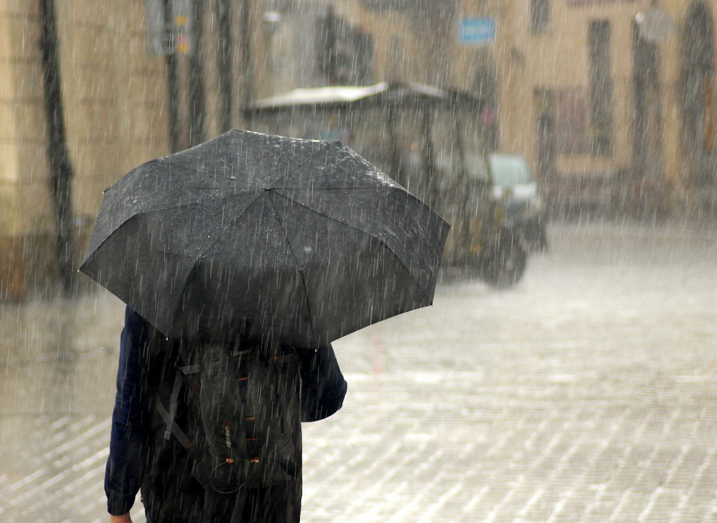
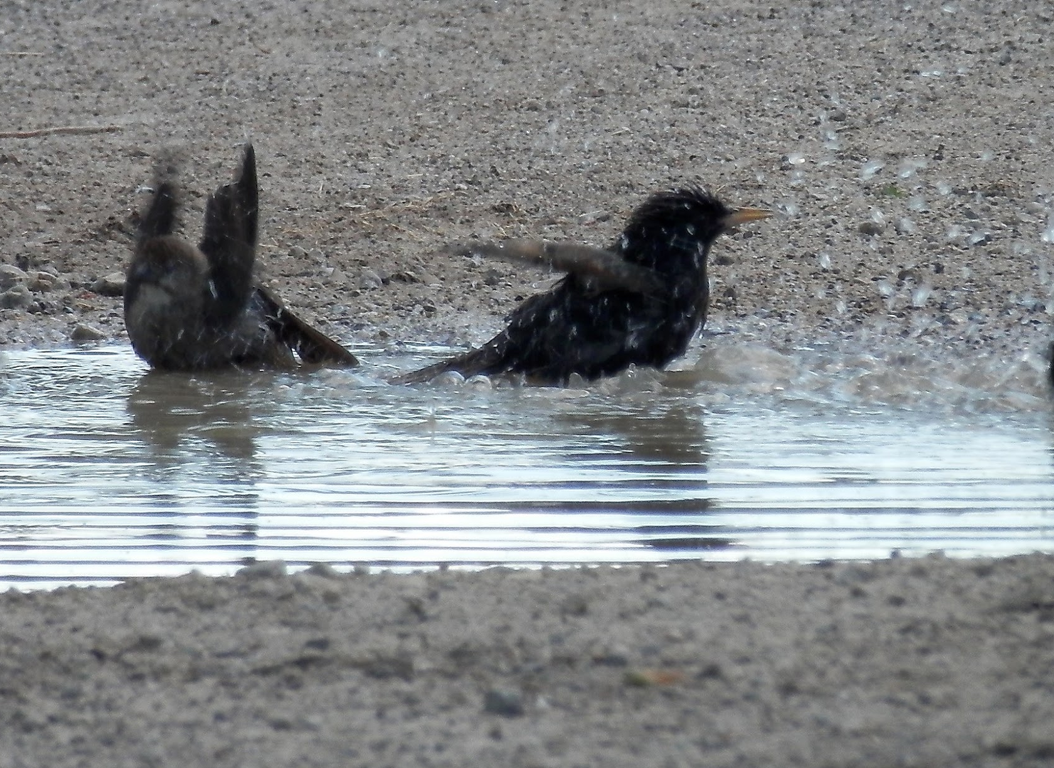
First, click the audio button.
Then, click each photo to learn more!

Slide 7
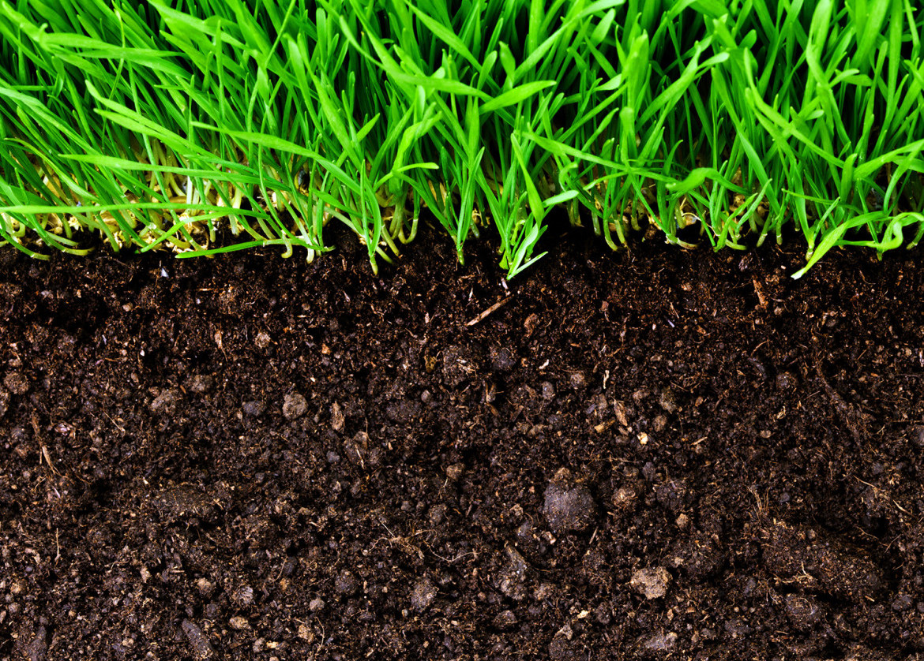
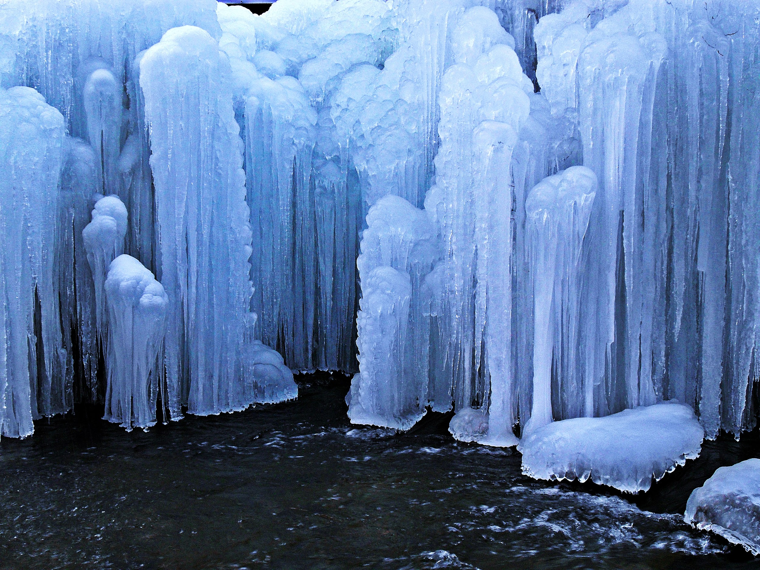
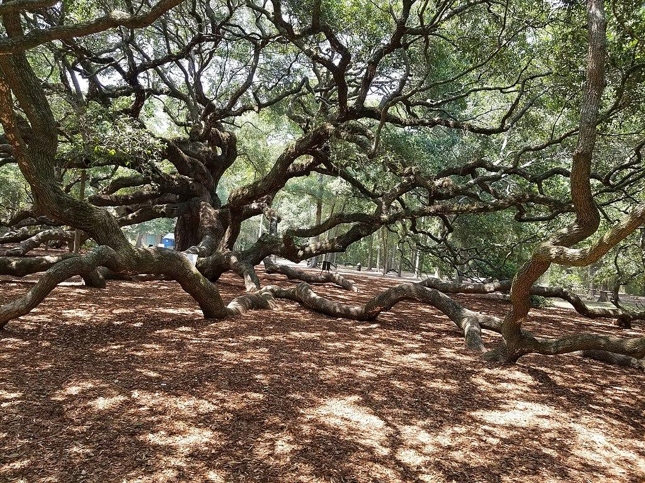
First, click the audio button.
Then, click each photo to learn more!

Slide 8
Activity: Sort it Out!
Instructions:
On the next slide, you will be given a variety of pictures. How would you sort these different images into groups? Drag and sort these images into groups based on different patterns you see. There will be two slides for you to group the images in two different ways. Have fun and be creative!
Being curious
Being creative
Notes:
For this activity, we’re going to work on being curious and creative!

Slide 9
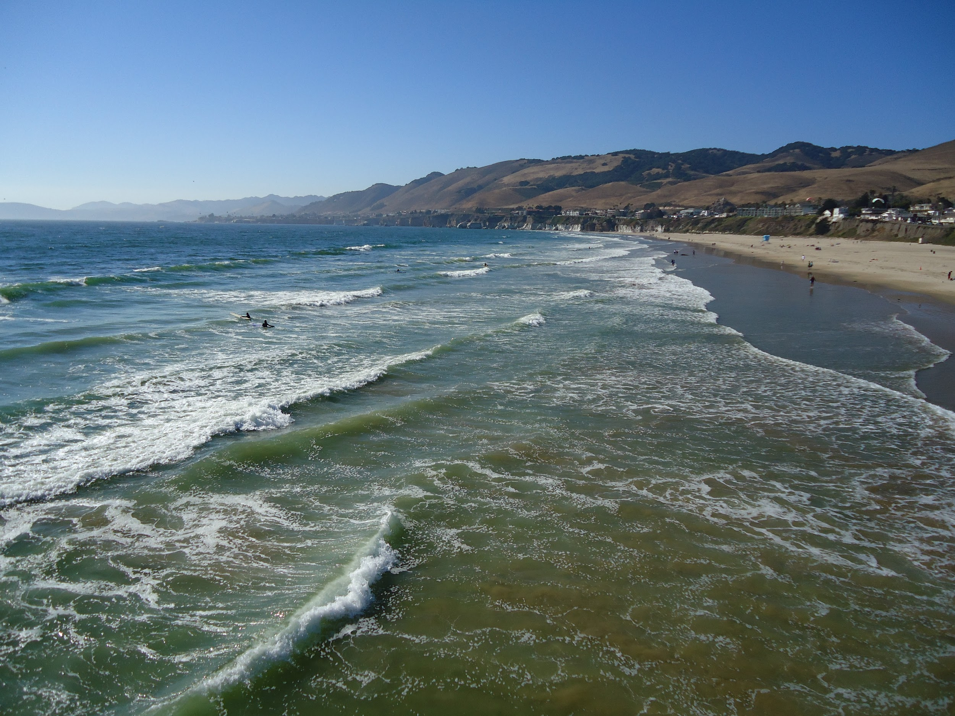
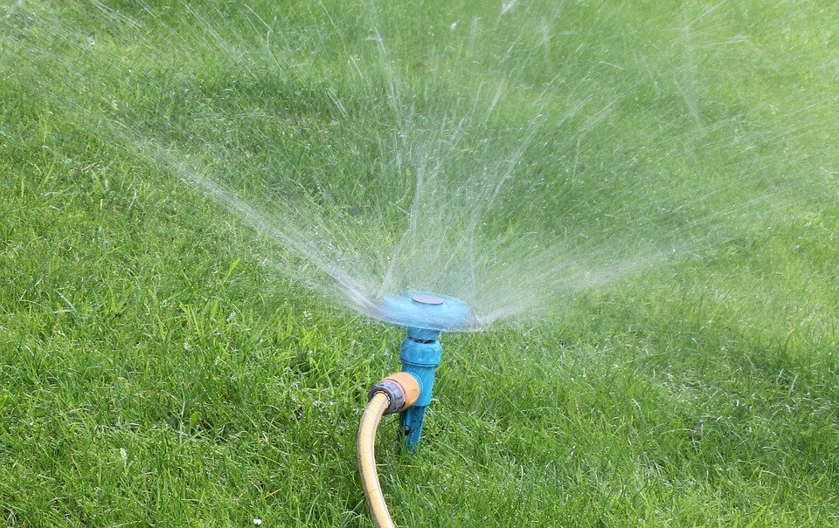
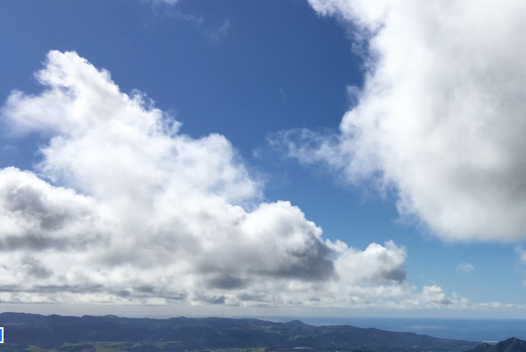
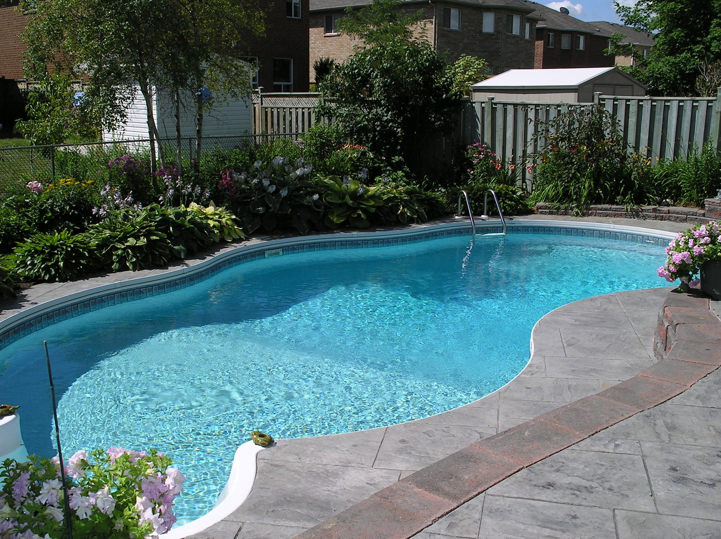
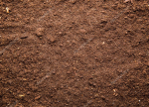
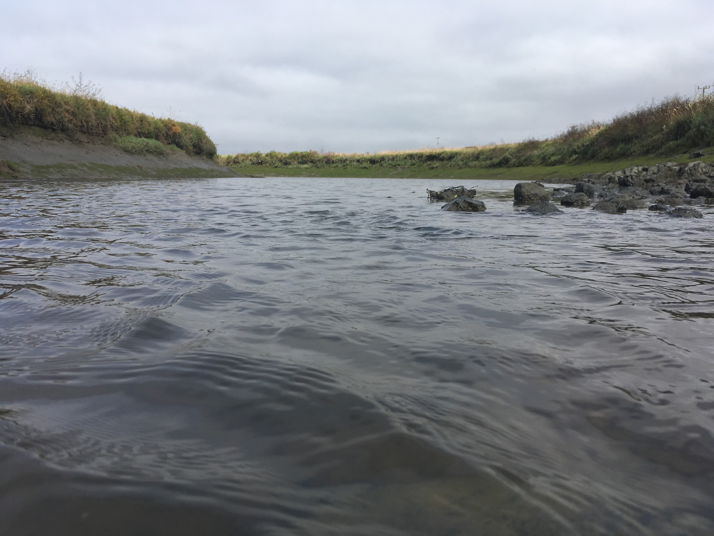

Slide 10
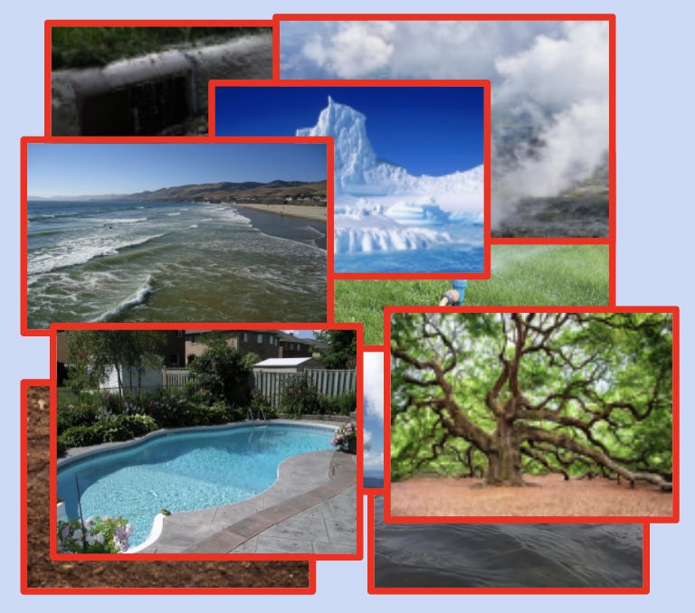
Discuss how you organized your cards!
Your teacher will now put you into groups of 4 or 5
Talk with your group about how and why you grouped your cards the way you did
Do you notice any similarities or differences?
Which method of sorting was the most effective and why?
Being open minded
Speaking up and sharing my ideas
Pausing for others to speak
Notes:
When you’re in your groups, remember to be open minded to new ideas, to speak up and share your own ideas, and to pause and let others speak.

Slide 12
What patterns did you see?
Maybe you grouped them by…

Slide 13
What patterns did you see?
Maybe you grouped them by…
Color

Slide 14
What patterns did you see?
Maybe you grouped them by…
Location
Color

Slide 15
What patterns did you see?
Maybe you grouped them by…
Location
Color
Water repelled
versus
water absorbed

Slide 16
What patterns did you see?
Maybe you grouped them by…
Location
Color
Water phase
(liquid, solid, vapor)
Water repelled
versus
water absorbed

Slide 17
What patterns did you see?
Maybe you grouped them by…
Location
Color
Water phase
(liquid, solid, vapor)
Water repelled
versus
water absorbed
What did you observe?

Slide 18
What did we do today? Let’s review!
We learned water is everywhere!
We looked at different pictures and sorted them into groups.
We discussed what patterns we might have seen.
In the next lesson (Part B) we will take another look into these pictures and what they have in common.
SEE YOU NEXT TIME!

Slide 19
Lesson 1, Part B: Water in Nature
Notes:
Welcome back to protecting our watersheds! In this next session, we will review what patterns we saw in the last activity and dive further into the effects of water in nature!

Slide 20
What skills will we use today?
Asking for help
Thinking like a scientist
Staying focused
Being Curious
Sharing equipment
Notes:
In our investigation today we will have a chance to work on our evaluating and analyzing skills, our critical thinking skills, and our organizational skills. These skills include thinking like a scientist, being curious, staying focused, asking for help, and sharing equipment. Where are these skills on your comfort zone scale?

Slide 21
Growth Edge
Comfort Zone
YIKES!
Notes:
Think about where the previous skills land in your comfort zone. Are they in the middle of your comfort zone, closer to the growth edge, or in the yikes zone? Today is a great day to work around your growth edge!

Slide 22
What do you remember from Water in Nature Part A?
Think back to Part A of this lesson - what did you explore?
What activity did you do?
How did you sort the pictures?
Did you learn anything new after sharing with your groups?
Notes:
What do you remember from our last session with Protecting our Watersheds? Think back to part a of this lesson, what did you explore? What activity did you do? How did you sort the pictures? Did you learn anything new after sharing with your groups?

Slide 23
What if we put ALL the pictures into one group?
What do all the pictures have in common?

Slide 24
What if we put ALL the pictures into one group?
What do all the pictures have in common?
WATER!

Slide 25
Investigation Time!
Asking for help
Remember our Focus Question:
What is the effect of rain on natural materials?
Staying focused
We will be using droppers and water to place simulated raindrops on different natural surfaces outdoors and observe what happens.
Think like a scientist
Being Curious
Sharing equipment
Notes:
Think about how you can use these skills during the investigation!

Slide 26
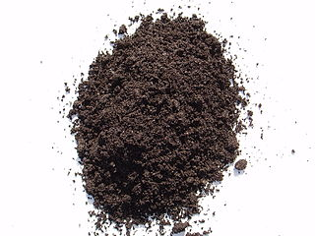
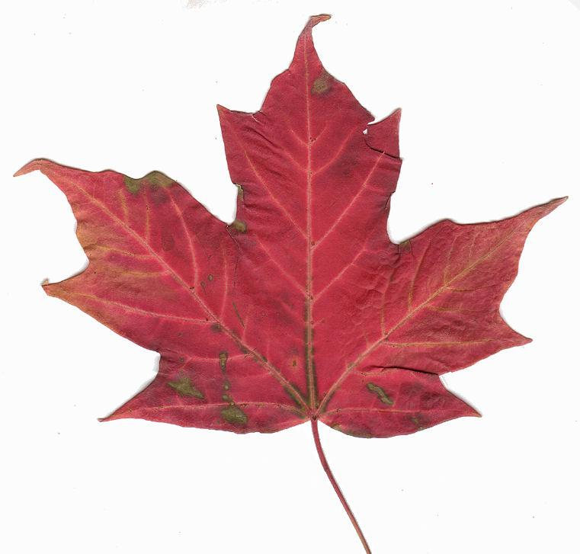
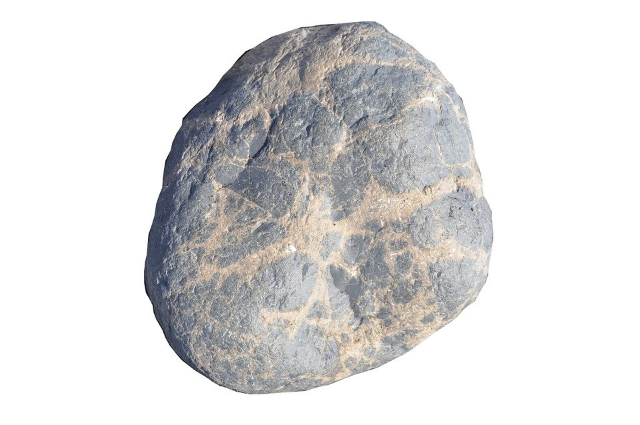
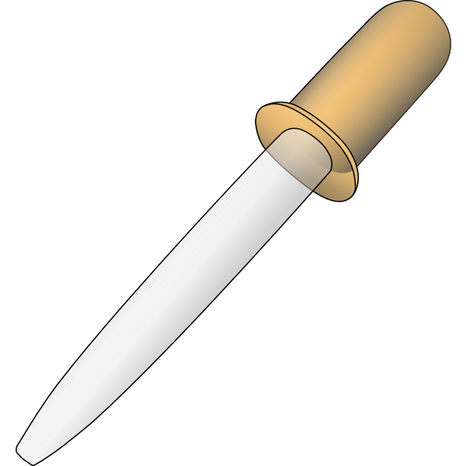
Investigation Time!
Procedure:
Find 4 different natural objects outside
(examples: rocks, dirt, sand, leaves)
Using a dropper with water, test the objects to see if they repel water (are waterproof) or absorb water.
Record your observations.
You can test more objects the next time you explore outdoors!

Slide 27
What did you observe?
Focus Question: What is the effect of rain on natural materials?
Write down or draw your observations in your notebooks:
I noticed… I wonder… It reminds me of…

Slide 28
Vocabulary Review
Natural Material - any material that makes up or comes from the earth; earth material
Natural Resource - a material, such as soil or water, that comes from the natural environment that supports life and meets people’s needs
Repel - to resist absorbing or passing a liquid, such as water
Absorb - to take in or soak up

Slide 29
Thanks for exploring with us!

